Slide 1
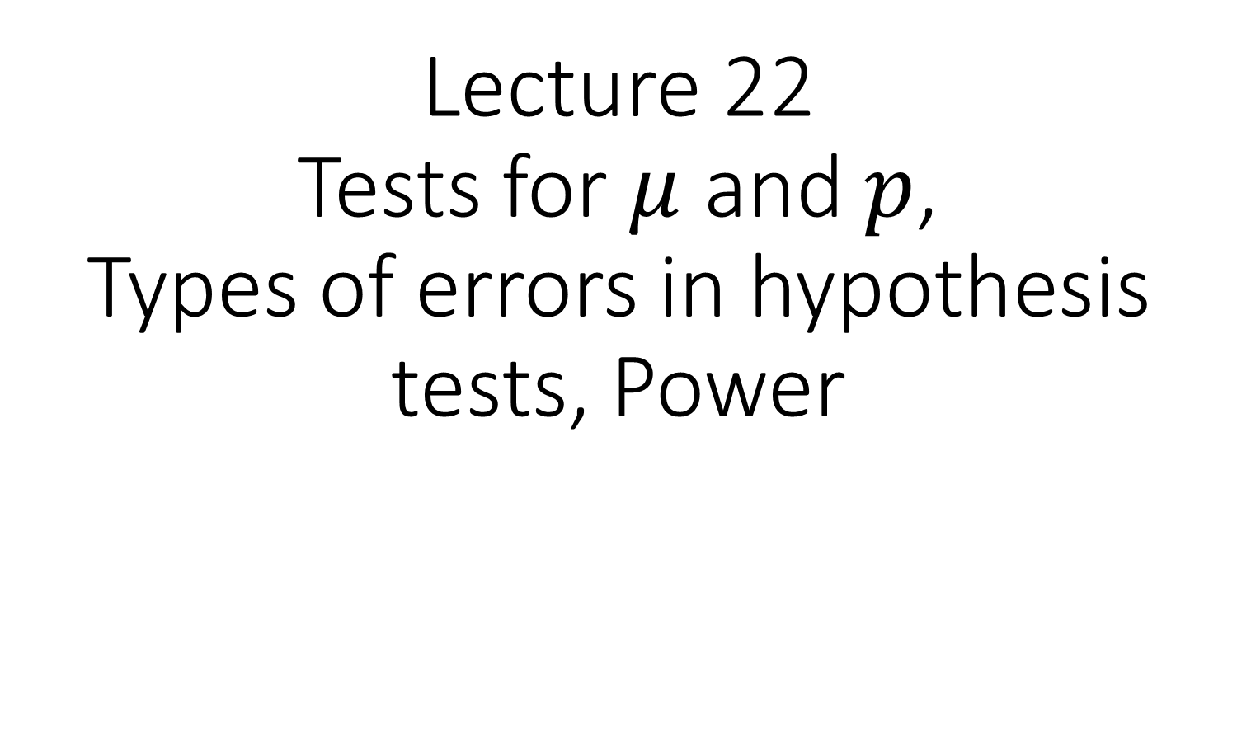
Lecture 22 Tests for $μ$ and $p$, Types of errors in hypothesis tests, Power

Slide 2
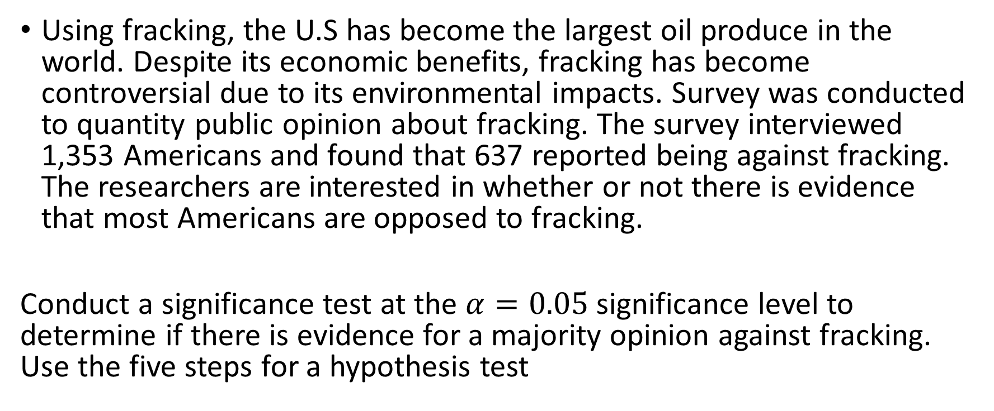
Warm Up
Using fracking, the U.S has become the largest oil produce in the world. Despite its economic benefits, fracking has become controversial due to its environmental impacts. Survey was conducted to quantity public opinion about fracking. The survey interviewed 1,353 Americans and found that 637 reported being against fracking. The researchers are interested in whether or not there is evidence that most Americans are opposed to fracking.
Conduct a significance test at the $α=0.05$significance level to determine if there is evidence for a majority opinion against fracking. Use the five steps for a hypothesis test

Slide 3
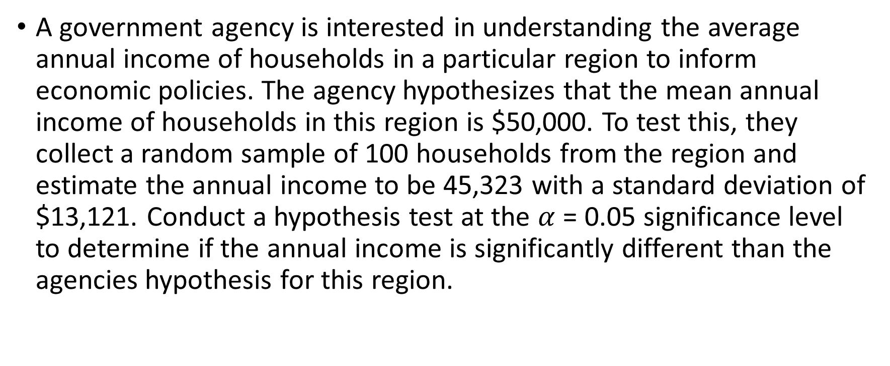
Warm Up
A government agency is interested in understanding the average annual income of households in a particular region to inform economic policies. The agency hypothesizes that the mean annual income of households in this region is $50,000. To test this, they collect a random sample of 100 households from the region and estimate the annual income to be 45,323 with a standard deviation of $13,121. Conduct a hypothesis test at the $α$ = 0.05 significance level to determine if the annual income is significantly different than the agencies hypothesis for this region.

Slide 4
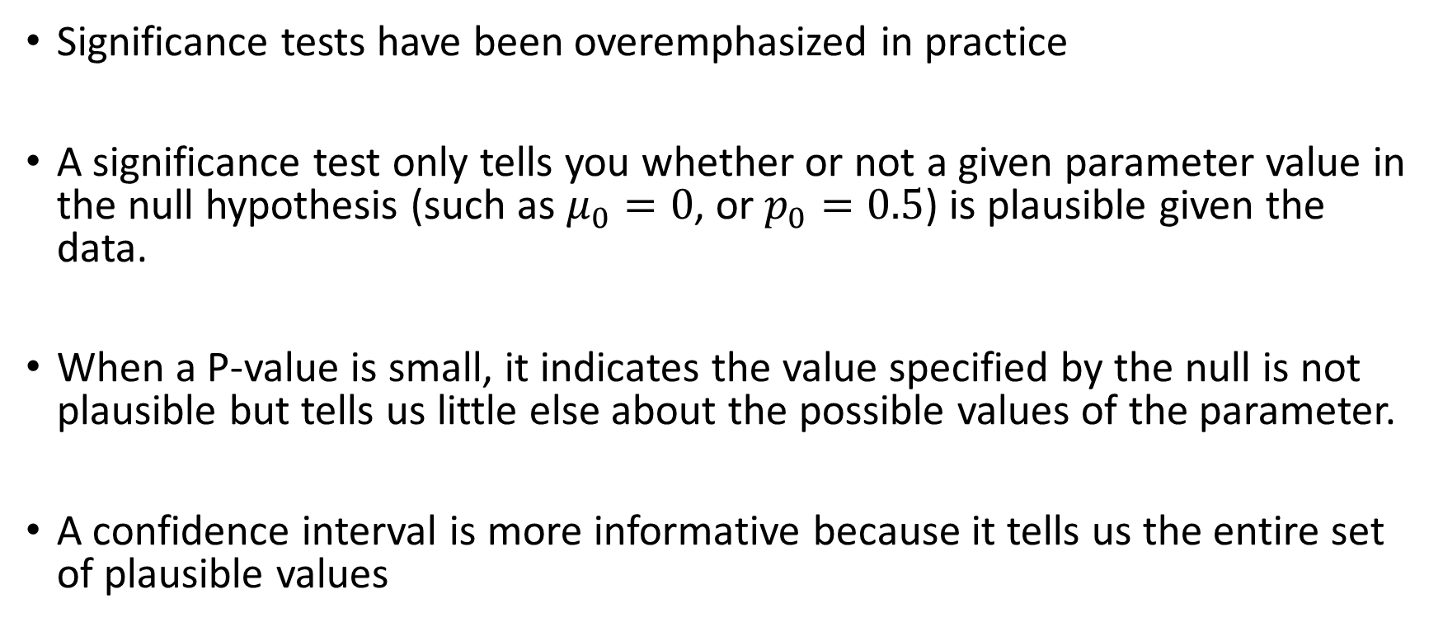
Significance tests are less useful than confidence intervals
Significance tests have been overemphasized in practice
A significance test only tells you whether or not a given parameter value in the null hypothesis (such as $μ_{0}=0$, or $p_{0}=0.5$) is plausible given the data.
When a P-value is small, it indicates the value specified by the null is not plausible but tells us little else about the possible values of the parameter.
A confidence interval is more informative because it tells us the entire set of plausible values

Slide 5
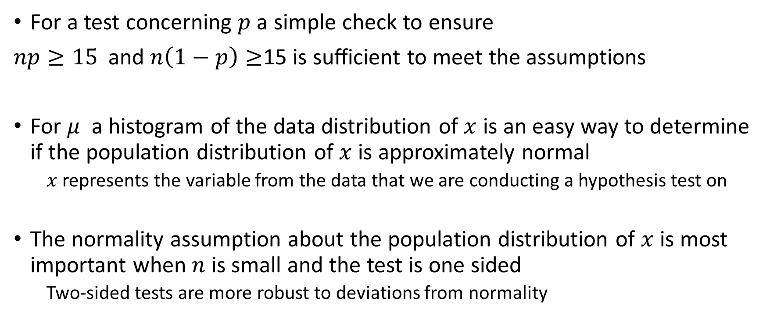
Checking Assumptions
For a test concerning $p$ a simple check to ensure
$np≥15$ and $n\left(1−p\right)≥$15 is sufficient to meet the assumptions
For $μ$ a histogram of the data distribution of $x$ is an easy way to determine if the population distribution of $x$ is approximately normal
$x$ represents the variable from the data that we are conducting a hypothesis test on
The normality assumption about the population distribution of $x$ is most important when $n$ is small and the test is one sided
Two-sided tests are more robust to deviations from normality

Slide 6
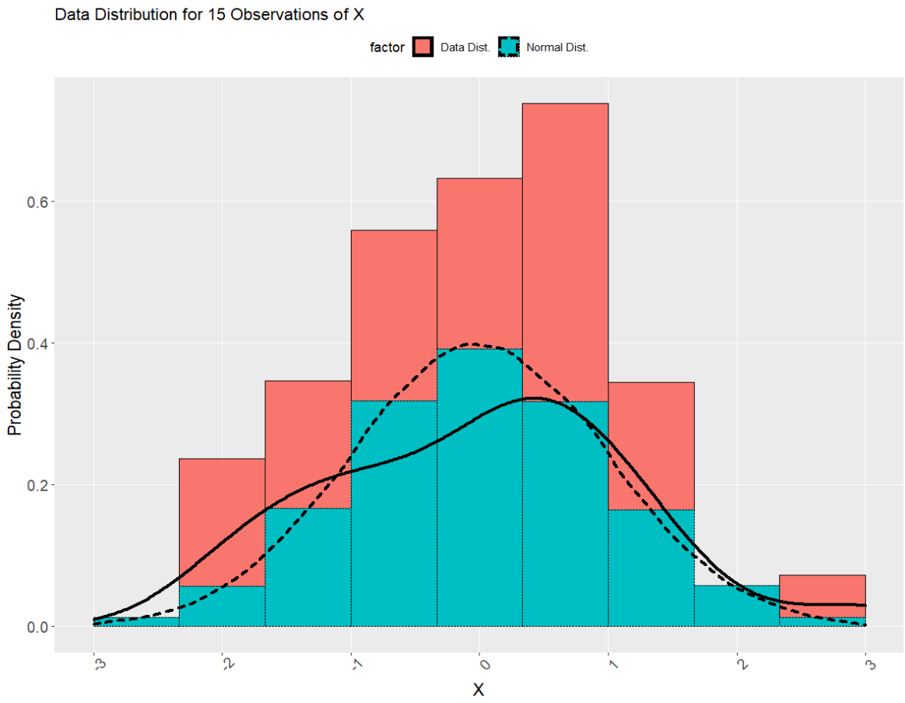

Slide 7
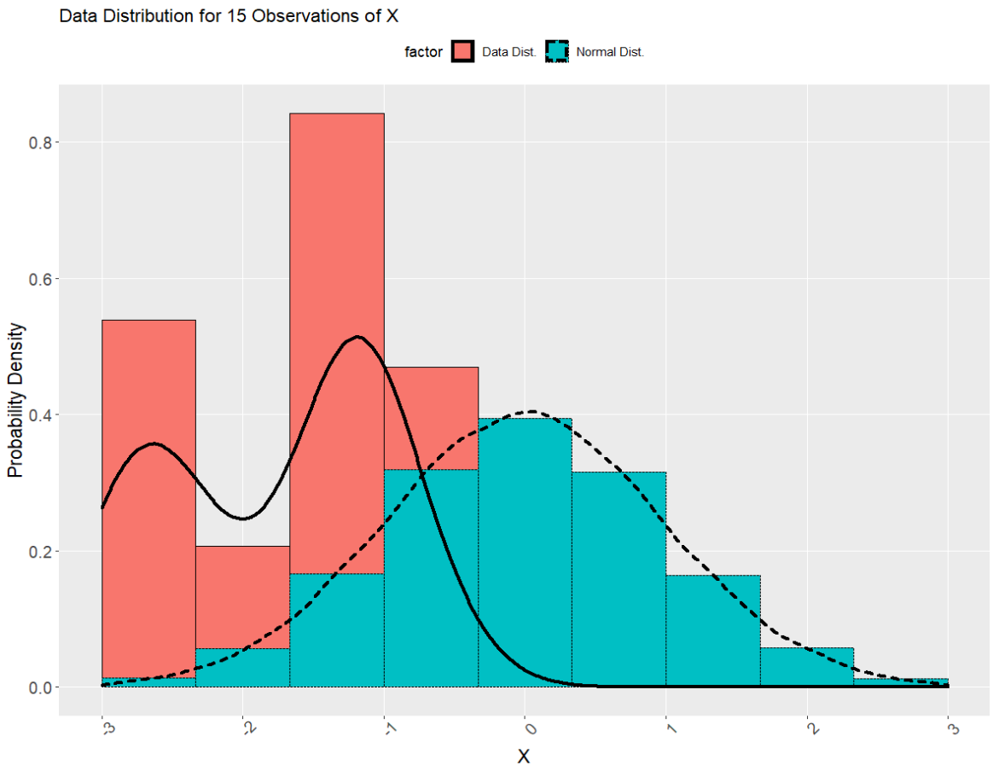

Slide 8
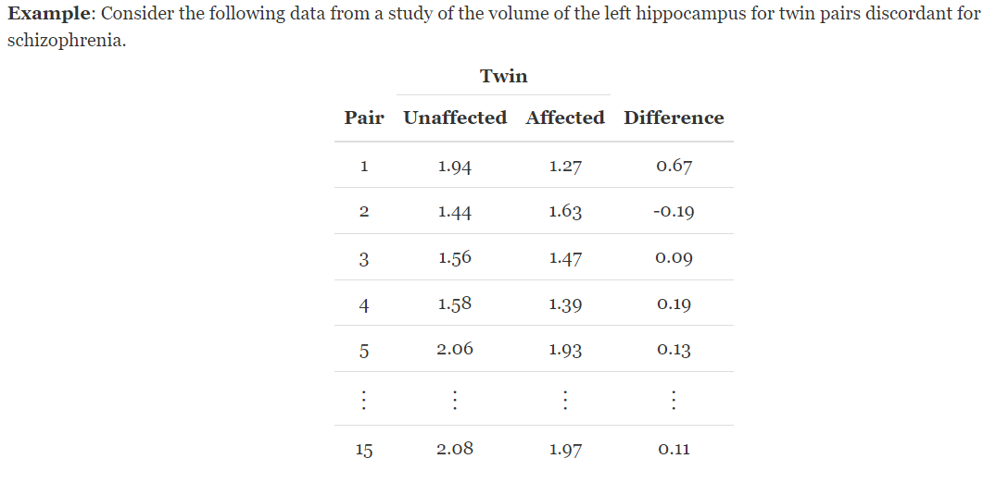
Example 1: Test for a population mean

Slide 9
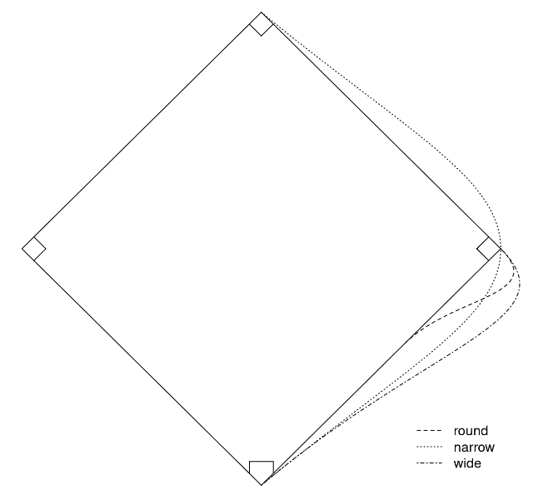
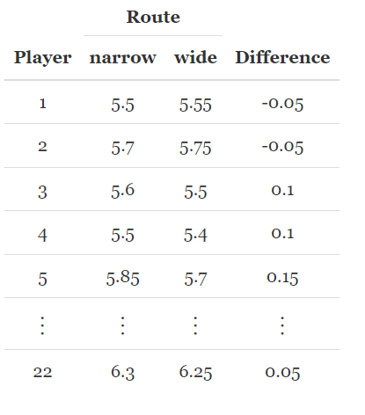
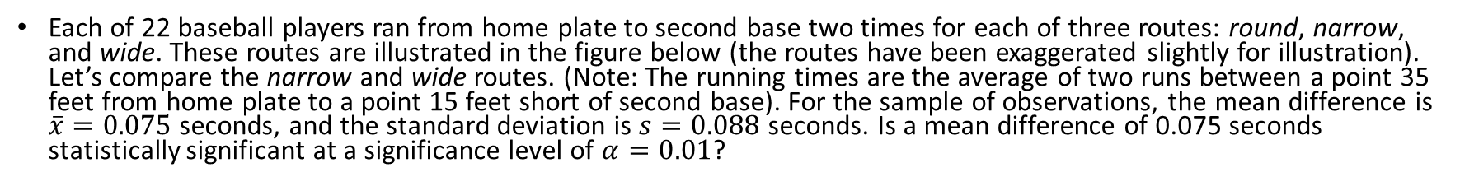
Another Example
Each of 22 baseball players ran from home plate to second base two times for each of three routes: round, narrow, and wide. These routes are illustrated in the figure below (the routes have been exaggerated slightly for illustration). Let’s compare the narrow and wide routes. (Note: The running times are the average of two runs between a point 35 feet from home plate to a point 15 feet short of second base). For the sample of observations, the mean difference is $\overline{x}=0.075$ seconds, and the standard deviation is $s=0.088$ seconds. Is a mean difference of 0.075 seconds statistically significant at a significance level of $α=0.01$?

Slide 10
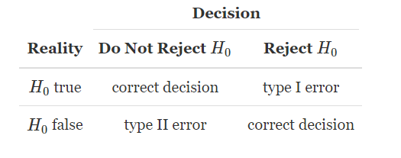
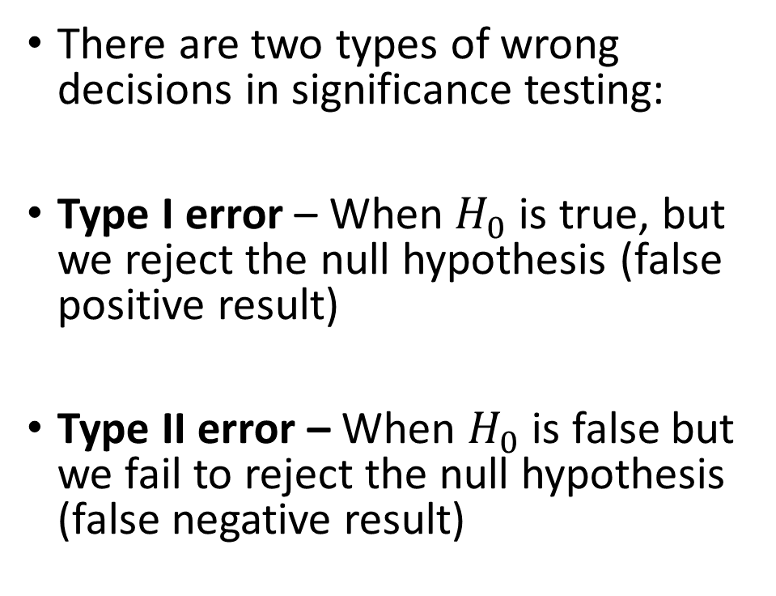
Types of errors in significance tests
There are two types of wrong decisions in significance testing:
Type I error – When $H_{0}$ is true, but we reject the null hypothesis (false positive result)
Type II error – When $H_{0}$ is false but we fail to reject the null hypothesis (false negative result)

Slide 11
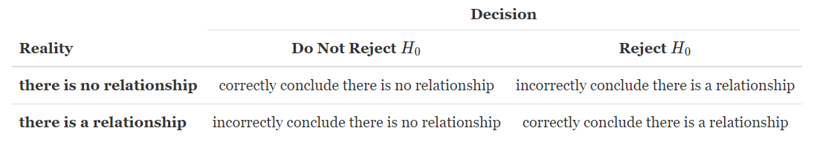

Ex.) Types of errors in significance tests
Recall the twin study that examined the relationship between schizophrenia and left hippocampus volume. Suppose the hypotheses are $H_{0}:μ_{0}=0$ (there is no relationship) and $H_{A}:μ≠μ_{0}$ (there is a relationship).
We rejected $H_{0}$, if $H_{0}$ is true, what kind of error did we make?

Slide 12
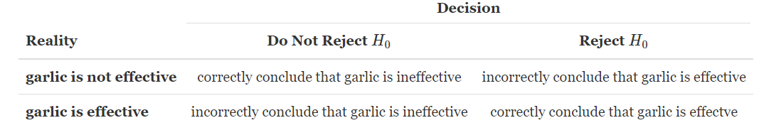

Ex.) Types of errors in significance tests
Recall the study with the cross-over design that investigated if garlic repels ticks. Suppose the hypotheses are $H_{0}:p_{0}=0.5$ (garlic is not effective) versus $H_{A}:p>p_{0}$ (garlic is effective).
We failed to reject $H_{0}$, if $H_{0}$ is actually false, what kind of error did we make?

Slide 13
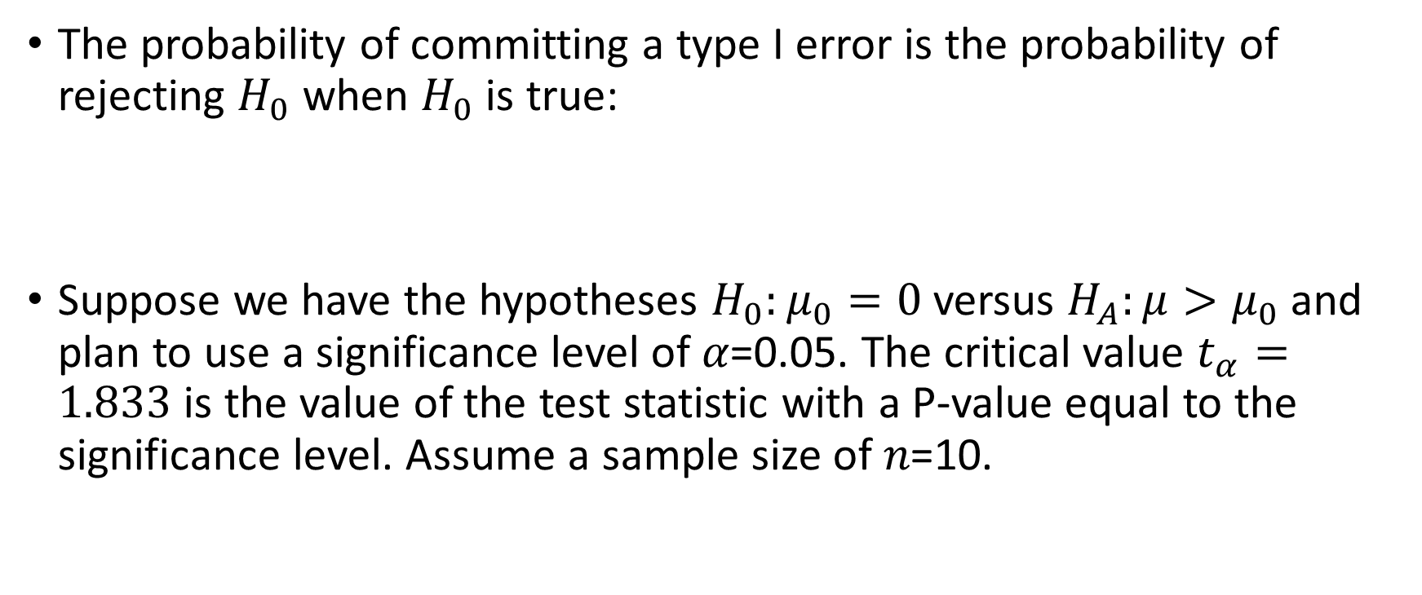
Probability of a type I error
The probability of committing a type I error is the probability of rejecting $H_{0}$ when $H_{0}$ is true:
Suppose we have the hypotheses $H_{0}:μ_{0}=0$ versus $H_{A}:μ>μ_{0}$ and plan to use a significance level of 𝛼=0.05. The critical value $t_{α}=1.833$ is the value of the test statistic with a P-value equal to the significance level. Assume a sample size of 𝑛=10.

Slide 14
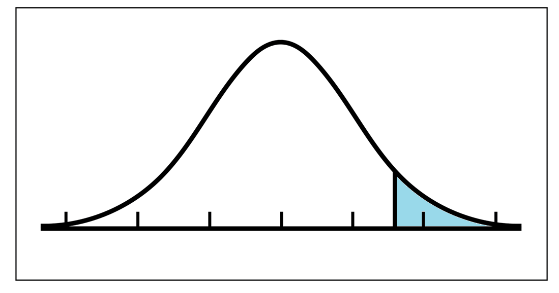

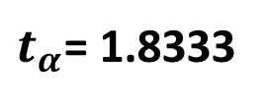



Suppose we have the hypotheses $H_{0}:μ_{0}=0$ versus $H_{A}:μ>μ_{0}$ and plan to use a significance level of $α=0.05$. The critical value $t_{α}$ is the value of the test statistic with a P-value equal to the significance level. Assume a sample size of $n=10$.
Reject $H_{0}$ if:
$t_{obs}>t_{α}$
Then $P\left(t>t_{obs} | H_{0} True\right)≤α$
Do NOT reject if:
$$t_{obs}<t_{α}$$
Then $P\left(t>t_{obs} | H_{0} True\right)>α$
$$α=P\left(t>t_{α}\right)$$
Rejection Region = $[t_{α},∞)$
Do Not Reject
$$H_{0}$$
0
$t_{α}$= 1.8333

Slide 15
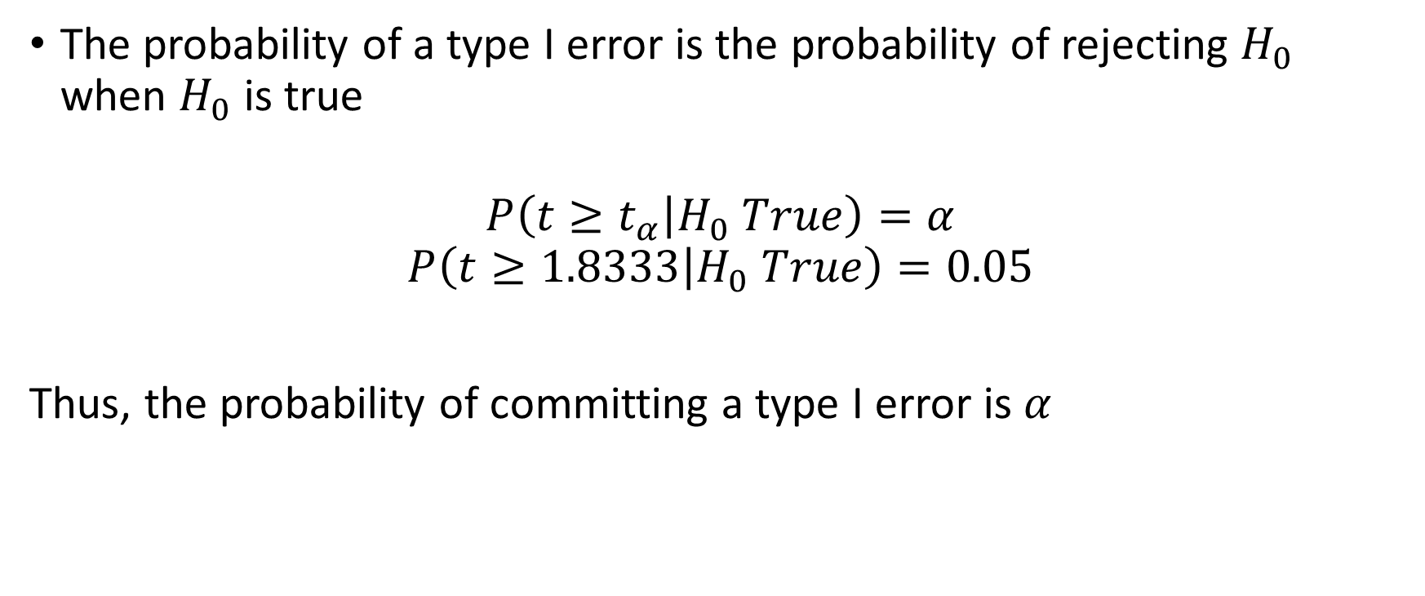
Probability of a type I error
The probability of a type I error is the probability of rejecting $H_{0}$ when $H_{0}$ is true
$$P\left(t≥t_{α} | H_{0} True\right)=α$$
$$P\left(t≥1.8333 | H_{0} True\right)=0.05$$
Thus, the probability of committing a type I error is $α$

Slide 16
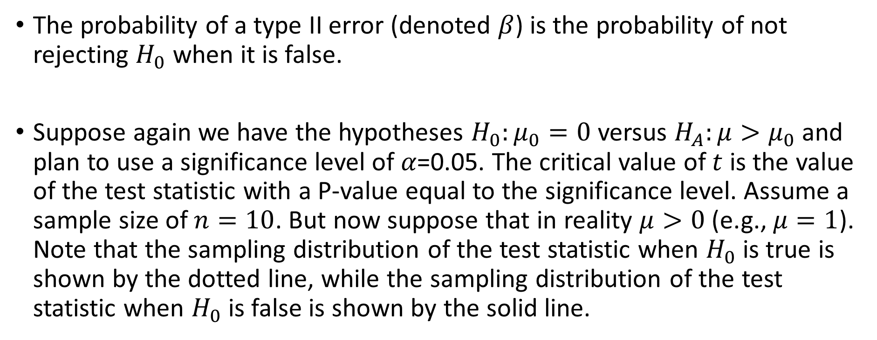
Probability of a type II error
The probability of a type II error (denoted $β$) is the probability of not rejecting $H_{0}$ when it is false.
Suppose again we have the hypotheses $H_{0}:μ_{0}=0$ versus $H_{A}:μ>μ_{0}$ and plan to use a significance level of 𝛼=0.05. The critical value of $t$ is the value of the test statistic with a P-value equal to the significance level. Assume a sample size of $n=10$. But now suppose that in reality $μ>0$ (e.g., $μ=1$). Note that the sampling distribution of the test statistic when $H_{0}$ is true is shown by the dotted line, while the sampling distribution of the test statistic when $H_{0}$ is false is shown by the solid line.

Slide 17
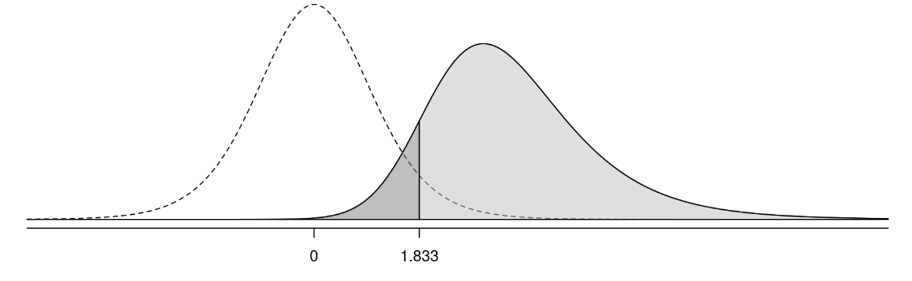
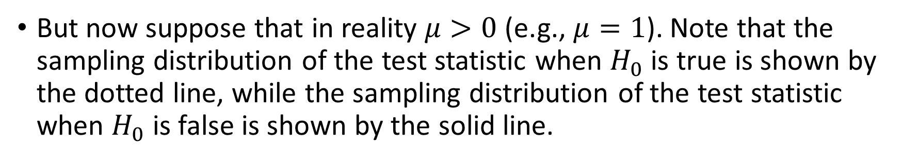
Probability of a type II error
But now suppose that in reality $μ>0$ (e.g., $μ=1$). Note that the sampling distribution of the test statistic when $H_{0}$ is true is shown by the dotted line, while the sampling distribution of the test statistic when $H_{0}$ is false is shown by the solid line.

Slide 18
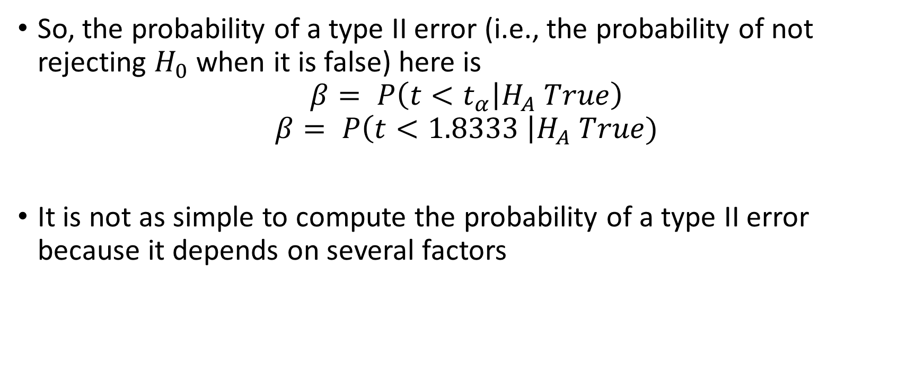
Probability of a type II error
So, the probability of a type II error (i.e., the probability of not rejecting $H_{0}$when it is false) here is
$$β= P\left(t<t_{α} | H_{A} True\right)$$
$$β= P\left(t<1.8333 \right|H_{A} True)$$
It is not as simple to compute the probability of a type II error because it depends on several factors

Slide 19
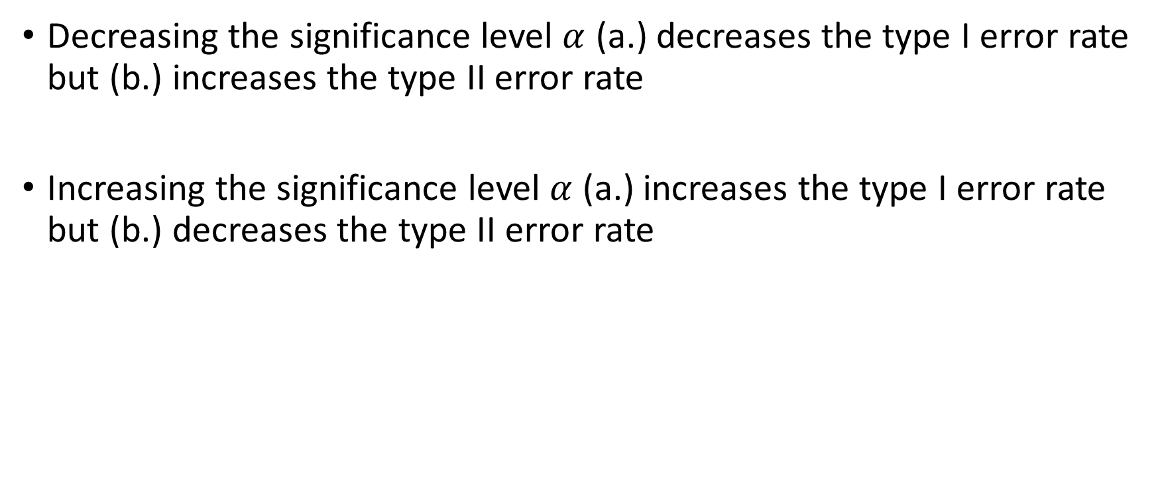

The effect of $α$ on error probabilities
Decreasing the significance level $α$ (a.) decreases the type I error rate but (b.) increases the type II error rate
Increasing the significance level $α$ (a.) increases the type I error rate but (b.) decreases the type II error rate

Slide 20
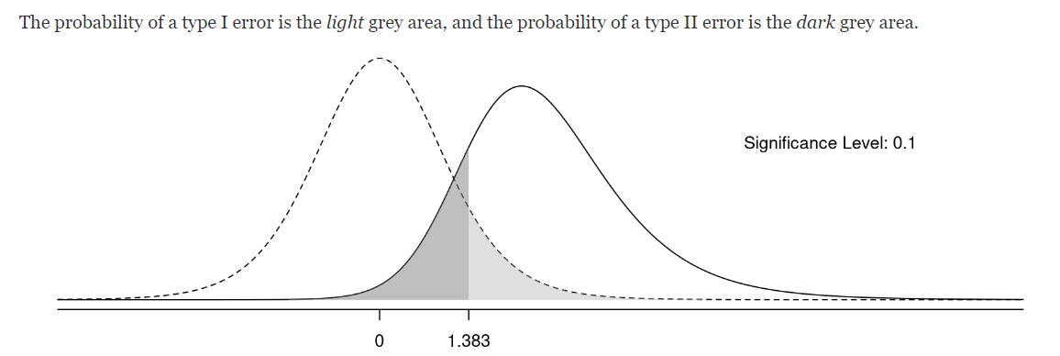
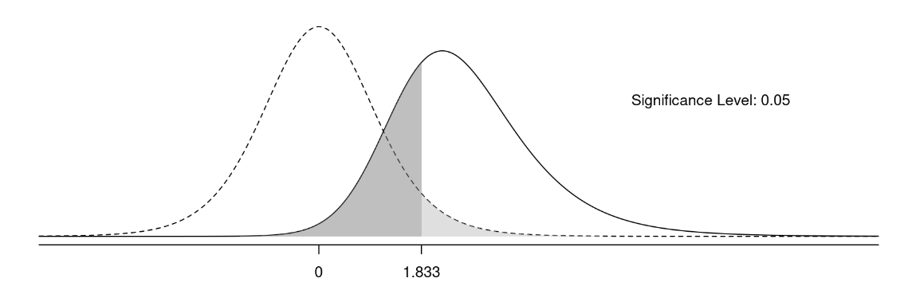
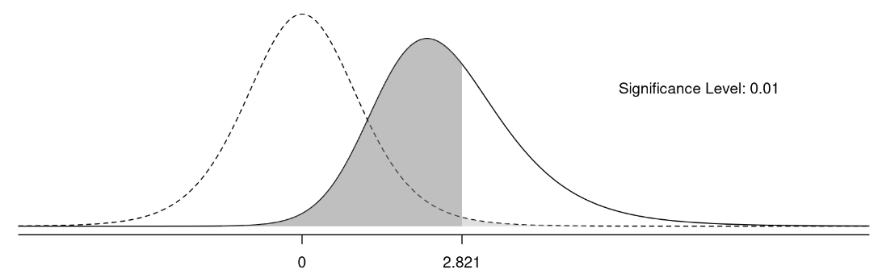

Slide 21
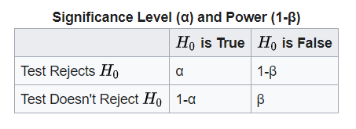
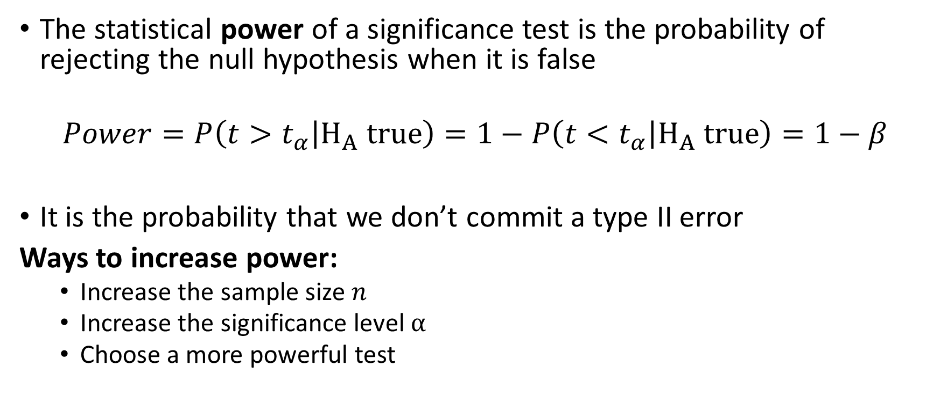
Power
The statistical power of a significance test is the probability of rejecting the null hypothesis when it is false
$$Power=P\left(t>t_{α} | H_{A} true\right)=1−P\left(t<t_{α} | H_{A} true\right)=1−β$$
It is the probability that we don’t commit a type II error
Ways to increase power:
Increase the sample size $n$
Increase the significance level $α$
Choose a more powerful test

Slide 22
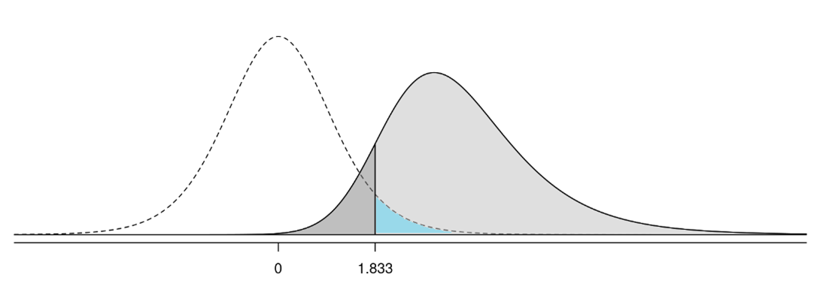


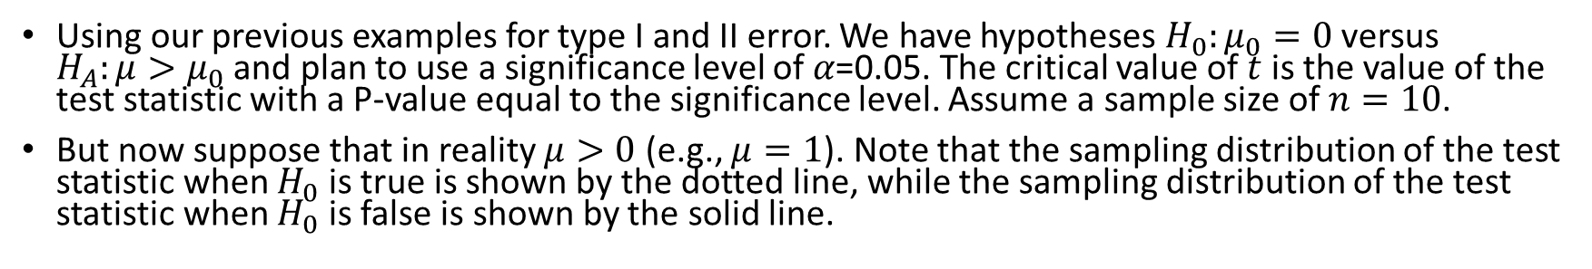



Type I, Type II, and Power
Using our previous examples for type I and II error. We have hypotheses $H_{0}:μ_{0}=0$ versus $H_{A}:μ>μ_{0}$ and plan to use a significance level of 𝛼=0.05. The critical value of $t$ is the value of the test statistic with a P-value equal to the significance level. Assume a sample size of $n=10$.
But now suppose that in reality $μ>0$ (e.g., $μ=1$). Note that the sampling distribution of the test statistic when $H_{0}$ is true is shown by the dotted line, while the sampling distribution of the test statistic when $H_{0}$ is false is shown by the solid line.
Distribution under $H_{0}$
Distribution under $H_{A}$
Power $=1−β$
Type II error $β$
Type I error $α$

Slide 23
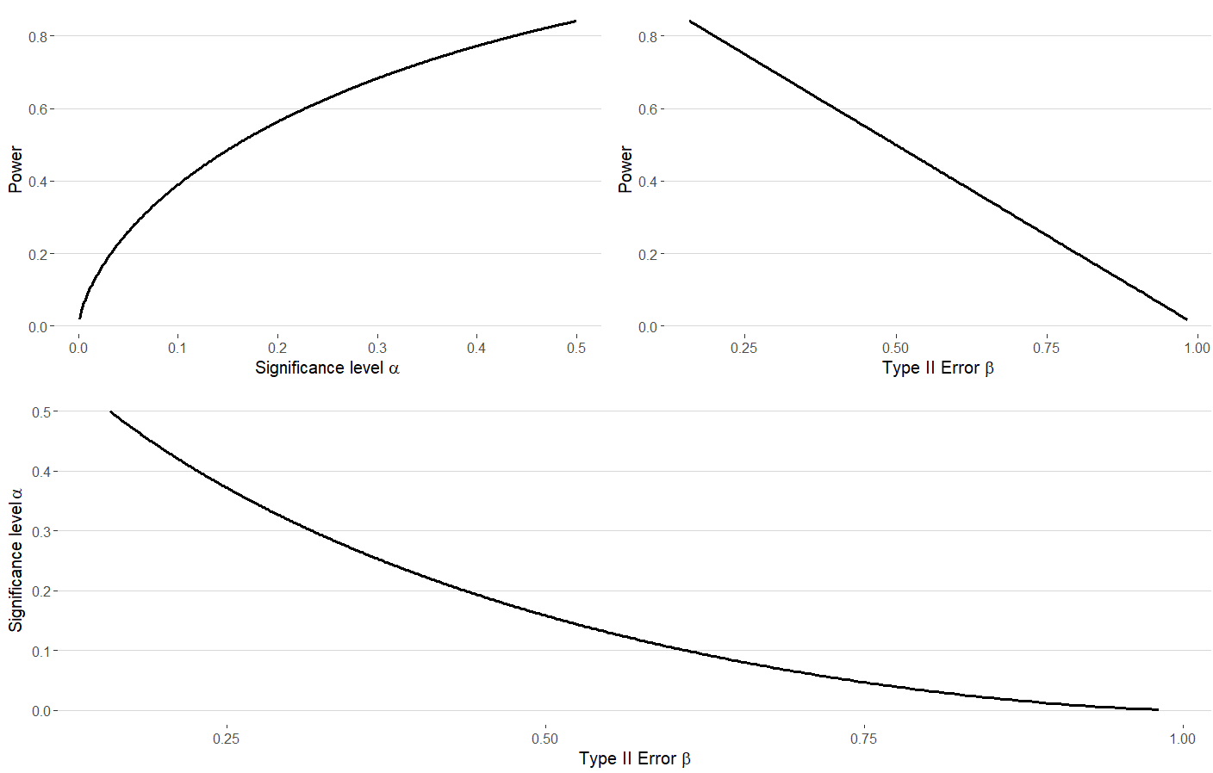
Relationship between power, $α,$ and $β$

